Slide 1
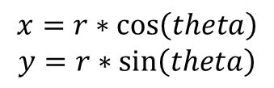
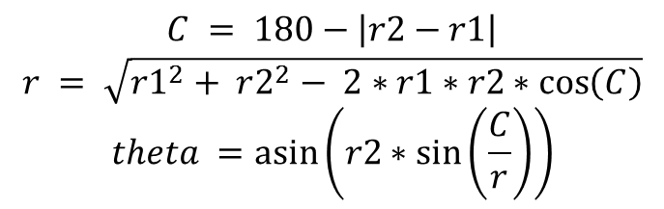
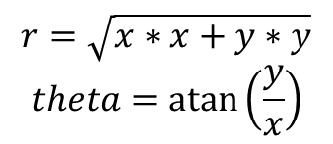
Addition as Polar
Addition as Cartesian
Polar + Polar
Polar + Polar
$$x=r∗\cos\left(theta\right)$$
$$y=r∗\sin\left(theta\right)$$
$$C = 180−\left|r2−r1\right|$$
$$r = \sqrt{r1^{2}+ r2^{2}− 2∗r1∗r2∗\cos\left(C\right)}$$
$$theta =\operatorname{asin}\left(r2∗\sin\left(\frac{C}{r}\right)\right)$$
Cart + Cart
Cart
$$r=\sqrt{x∗x+y∗y}$$
$$theta=\operatorname{atan}\left(\frac{y}{x}\right)$$
Polar
Polar

